Slide 1


Sinhgad Academy of Engineering Department of Information Technology
Academic Year 2024-25
BE Project Review No : 2
On
Vocal Mail: An Accessible Email System for the Visually Impaired
By :
Members Name
1) Nandini Rawool
2) Jayesh Sasane
3) Shravankumar Rakhunde
4)Anuska Jadhav
Guide Reviewer Prof.N.G.Gunaware Dr.S.L.Bangare
Project title

Slide 2
Introduction
The visually challenged people find it very difficult to utilize this technology because of the fact that using them requires visual perception. However not all people can use the internet.
This is because in order to access the internet you would need to know what is written on the screen. If that is not visible it is of no use.
This makes internet a completely useless technology for the visually impaired and illiterate people. In this system mainly three types of technologies are used namely: STT (Speech-to-text), here whatever we speak is converted to text.
Text to speech:- and the second time if email which is in inbox will be read out to the blind person using text to speech conversion.

Slide 3
AIM AND OBJECTIVE
1. Aim
• To enable Blind People to handle mail system.
2. Objectives
Provide login security with Face detection.
Options to add, send, delete, and conduct all of the necessary functions.
Attachment of files by voice.
Can be used in Regional Languages

Slide 4
Literature Survey
Title | Authors/Year | Work Description | Problem Found | Proposed Solution | Algorithms/Technologies Used | Unique Features
The Way to Make Blind People Use the Email System: Voice-Based Email Generating System Using AI | Gaurav Kumar Rajput, Sachin Sharma, Dr. Bibhu Prasad Dash, Dr. Meraj Farheen Ansari, Pawankumar Sharma, Dr. Surendra Kumar Shukla-2023 | Proposes a voice-based email system using AI to enable blind people to use email independently. | Traditional email systems are not accessible for blind users. | Utilizes speech-to-text, text-to-speech, and an AI-based interface. | Speech-to-Text (STT), Text-to-Speech (TTS), AI for Speech Recognition, NLP | AI and NLP for enhanced speech recognition and natural language understanding.
Speech Recognition Email System for People with Impaired Sights | Pratik Kanani, Ayush Jain, Preet Gada, Aditya Rakshe, Yogesh Jha-2023 | Introduces a speech recognition email system allowing visually impaired individuals to compose and read emails. | Existing email systems are difficult for visually impaired users to navigate. | Uses Google Speech Recognition API, GTTS library, and IMAP protocol for a command-based voice email system. | Google Speech Recognition API, GTTS library, IMAP protocol | Command-based interface allowing specific commands like "SEND" or "READ".

Slide 5
Literature Survey
Title | Authors/Year | Work Description | Problem Found | Proposed Solution | Algorithms/Technologies Used | Unique Features
Human computer interactrion(HCI) Based smart voice Email Application | Sherly Noel | Provides an overview of a voice-based email system with voice recognition for authentication and voice commands. | Visually impaired users face challenges with traditional email systems due to reliance on visual interfaces. | Combines voice recognition for authentication with TTS and STT for email interaction, using Google APIs. | voice Recognition, Text-to-Speech (TTS), Speech-to-Text (STT), Google APIs | Integration of voice recognition for authentication purposes.
Voice Automation Mail System for Visually Impaired | Malathi D, Dev Awasthi, Gopika S, Dorathi Jayaseeli-2023 | Develops a voice-activated email system specifically for visually impaired users | Visually impaired users struggle with conventional email systems. | Employs speech recognition and text-to-speech technologies for email interaction. | Speech-To-Text (STT), Text-To-Speech (TTS), Python's GTTS, SMTP | Focus on Python's GTTS for cross-platform text-to-speech conversion.

Slide 6
SCOPE
There can be wide scope of the system with its functionalities. It can consist of options for reading deleted and spam emails.
The system will be more in demand if it will be accessible in all the regional languages. It will promote interaction at a higher level as it will require nothing special to use the system.
We can add attachments of documents

Slide 7
ENVIRONMENT/TOOLS .
OpenCV - Python Framework
Anaconda (v3.6) - A good package and environment manager that comes with a lot of data scientific computing tools such as Numpy , Pandas and Matplotlib. The other benefit of Anaconda is it makes it easy to create custom python environments.

Slide 8
SOFTWARE / HARDWARE
Software Requirement :
IDE : Spyder
Coding Language : Python
Operating System : Window10
Hardware Requirements :
Processor : Pentium-IV
Speed : 1.1 GHz
RAM : 8 GB
Hard Disk : 500 GB

Slide 9
System Overview
The present proposed system is completely based on the user’s accessibility and easiness of the email system. In our system we make other modules like ,
1. Registration (Face Capture)
2. login(Face authentication)
3.Delete Mail
4.Compose mail
5. Read mail , Count Total Mail , Count Unseen mail.
6.We give more functionality for handicapped Person Or blind Person and In this project used for face authentication Or authentication By using Haar-Cascade algorithm. That system through they easily doing their work.

Slide 10
System Overview
7.They don’t need other people for doing their work.
8.This system make handicapped person independent for doing this work.
The system uses IVR (interactive voice response) in order to interact with the users.
When the users interact with the system it will automatically generate the voices to do the actions.

Slide 11
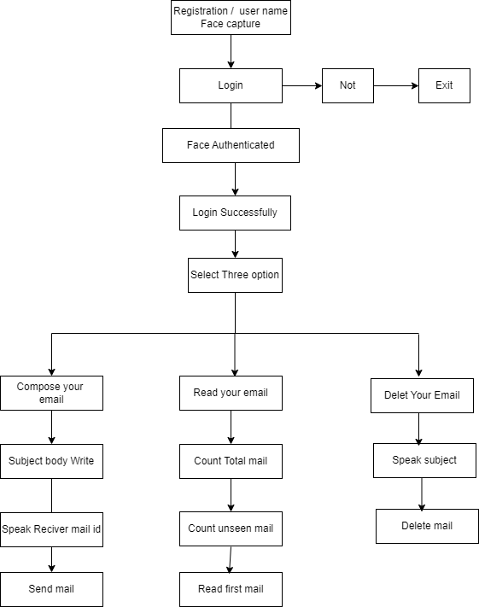
Architecture Diagram

Slide 12
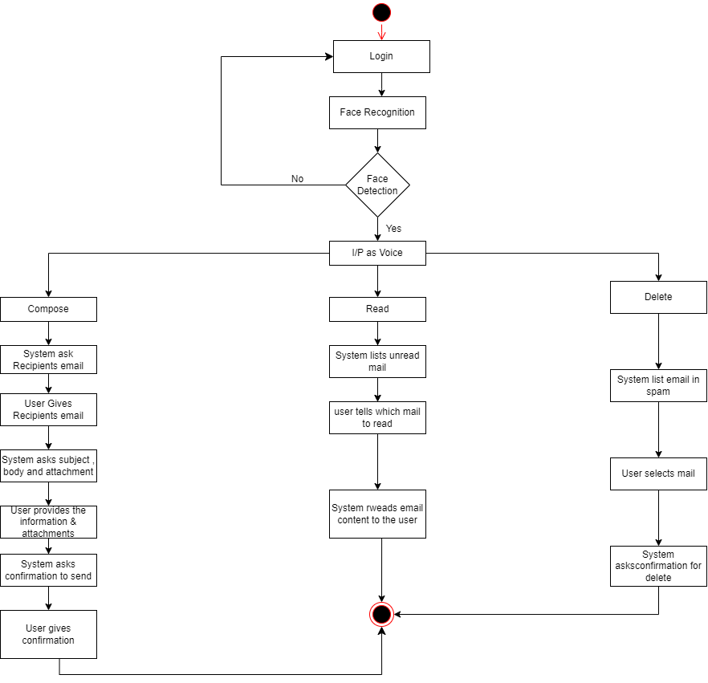
Activity Diagram

Slide 13
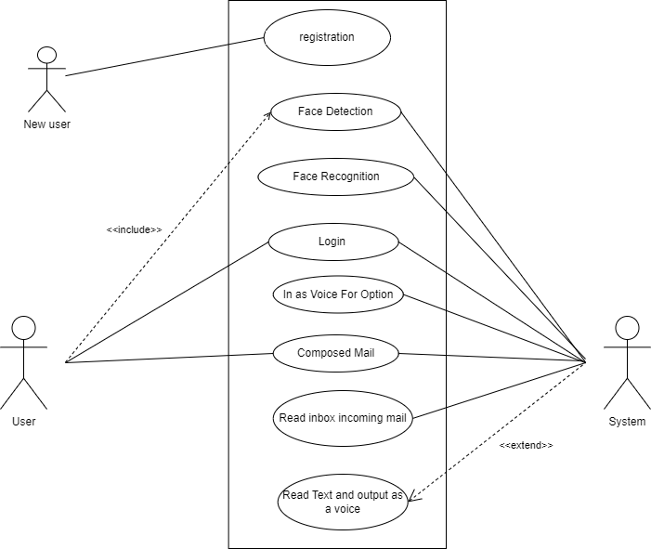
Use Case Diagram

Slide 14
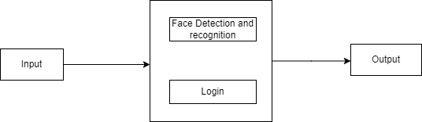
Data Flow Diagram level 0

Slide 15
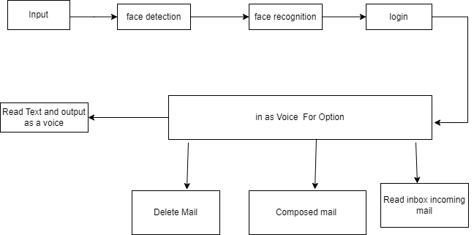
Data Flow Diagram level 1

Slide 16
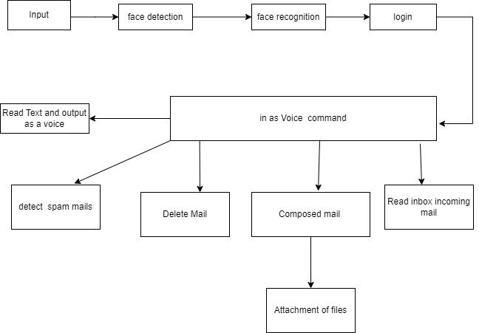
Data Flow Diagram level 2

Slide 17
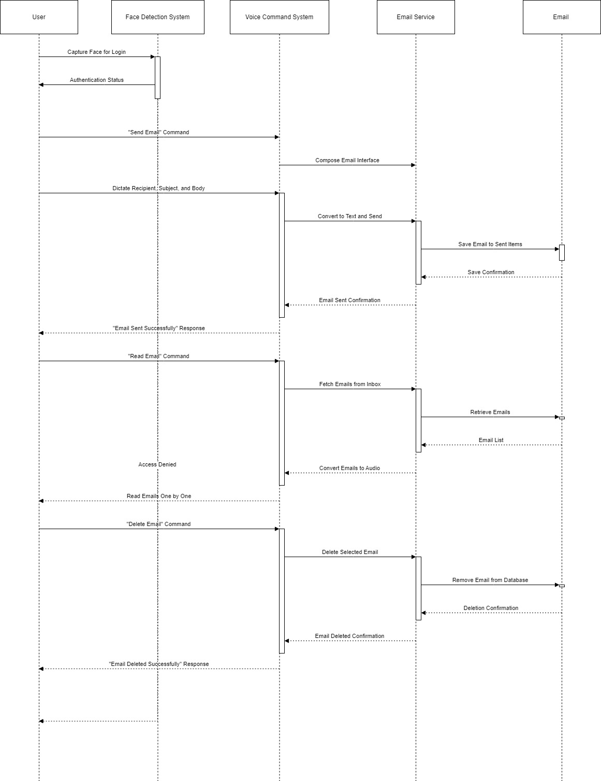
Sequence Diagram

Slide 18
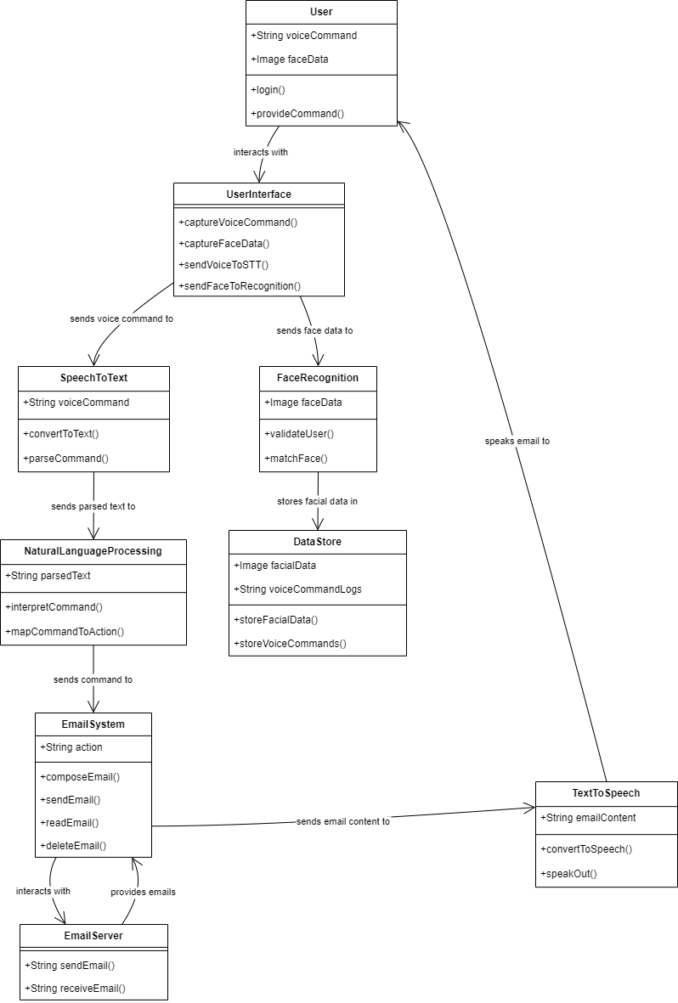
Class Diagram

Slide 19
PROJECT PLAN 1.0
Month Scheduled | Phase | Name of Group Members | Work done
July | Topic searching | 5/07/2024 | Topic Searched
 | Topic selection | 18/07/2024 | Topic Selected
 | Project confirmation | 22/07/2024 | Project Confirmed
August | Review 1 | 2/08/2024 | Review 1 Done
 | Final Review 1 | 7/08/2024 | Final Review 1 Done
September | Requirement Gathering | 03/09/2024 | Requirements Gathered
 | Coding | 25/09/2024 | Coded Different modules
October | Review 2 | 15/10/2024 | Review 2 Done

Slide 20
Conclusion .
Our project aims to help blind people access their emails easily using speech-to-text and text-to-speech methods.
It is designed for those who cannot read or write, facilitating communication through voice commands.
The system uses IVR voices without relying on keyboards, and operations are initiated via mouse clicks. Users only need to follow the voice instructions to perform actions, making the system efficient and accessible for blind individuals to manage emails through voice communication.

Slide 21
References
[1] The Way to Make Blind People Use the Email System: Voice Based Email Generating System Using Artificial Intelligence Gaurav Kumar Rajput; Sachin Sharma; Bibhu Prasad Dash; Meraj Farheen Ansari; Pawankumar Sharma; Surendra Kumar Shukla [2023]
[2] Speech Recognition Email System for People with Impaired Sights
Pratik Kanani; Ayush Jain; Preet Gada; Aditya Rakshe;Yogesh Jha [2023]
[3] Human computer interactrion(HCI) Based smart voice Email Application Sherly Noel [2020]
[4] Voice Automation Mail System for Visually Impaired Madhuri Rajole;Rajesh Phursule [2023]
[5] Performance analysis of Voice message service in CDMA cellular systems”- Song Liu, Zhisheng Niu and Dawei Huang [2020]
[6] Harivans Pratap Singh, Aman Pratap Kushwaha, Aayushmaan, Harendra Singh, “Voice-Based Email System”. International Journal of Innovative Science and Research TechnologyVolume 6, Issue 7, July – 2023
[7] Mullapudi Harshasri , Manyam Durga Bhavani , and Misra Ravikanth, “Voice Based Email for Blind”. - International Journal of Innovative Research in Computer Science & Technology (IJIRCST) ISSN: 2347-5552, Volume-9, Issue-4, July 2021

